Slide 1
New Segmentation Methods
Advisor : 丁建均 Jian-Jiun Ding
Presenter : 蔡佳豪 Chia-Hao Tsai
Date: 2010.11.08
Digital Image and Signal Processing Lab
Graduate Institute of Communication Engineering National Taiwan University

Slide 2
Outline
Interactive image segmentation by maximal similarity based region merging (MSRM) [1]
Automatic seeded region growing for color image segmentation (Color SRG algorithm) [2]
Notes:
[1]一般來說，”自動影像切割”對自然影樣是很況難處理，因為影像上的color & Texture feature太過複雜。此篇paper用了一個簡單的使用者輸入的互動設計去解決這問題。而使用者只需要一開始指出物體和背景的位置(markers)，再使用maximal similarity去判斷是否要做”區域合併”。

Slide 3
Introduction
The low level image segmentation:
Mean shift
Watershed
Level set [3]
Super-pixel [4]
Problem: Over segmentation
These low level segmentation methods provide a good basis for the subsequent high level operations.
Notes:
一般來說，低階的切割會有過度切割的問題，但它可以提供後面高階操作當做一個良好的基礎。

Slide 4
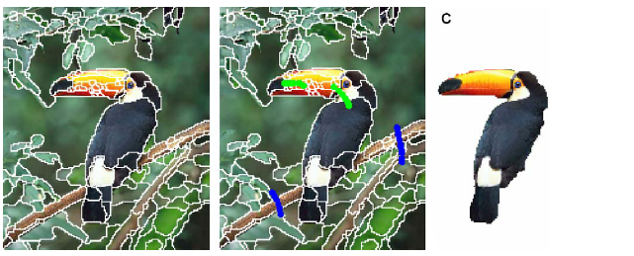
MSRM [1]
Fig. (a) Initial mean shift segmentation.
Fig. (b) The green lines: the object markers
The blue lines: the background markers.
Fig. (c) Segmentation result.
Notes:
Step1:使用mean shift，因為less over segmentation & 可以保留object的邊界。

Slide 5
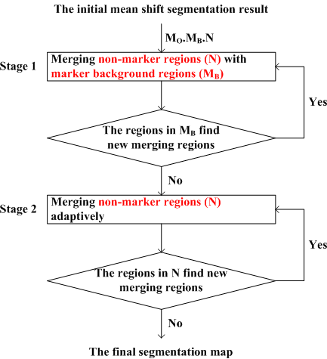
MSRM

Slide 6
MSRM
After mean shift initial segmentation, we have many small regions available.
we need to represent these regions using some descriptor and define a rule for merging.
A region can be described:
Color
Edge
Texture
Shape and Size
Notes:
在切割完後，會有很多小區域，我們要去找出能代表這些區域的descriptor &合併的rule。
而這篇PAPER使用color histogram去表示每個區域，因為一開始切完每個想要object的小區域，在Shape & Size
變化非常大，而不同區域的colors對於相同的object會有高相關性，故使用color histogram去表示每個區域。

Slide 7
MSRM
Using the RGB color space to compute the color histogram.
Uniformly quantize each color channel into 16 levels .
The histogram of each region is 16*16*16=4096 bins

Slide 8
MSRM
Use the Bhattacharyya coefficient to measure the similarity between R and Q .
Similarity measure :
and are the normalized histograms of R and Q .
Notes:
在marked and unmarked region去決定相關性，讓相似的區域可以合併起來。去做內積，可使noise& variations變robust。

Slide 9
MSRM
Bhattacharyya coefficient is the cosine of the angle between the unit vectors.
and
The higher the Bhattacharyya coefficient between R and Q is, the higher the similarity between them is.
Notes:
Bhattacharyya coefficient 的幾何解釋，為反映區域之間的視覺的相關性。若兩區域的內容非常相似，他們的histogram一定也會非常相似，因此他們的Bhattacharyya coefficient 也會非常高，亦即此兩個histogram vectors的angle會非常小。

Slide 10
MSRM
After object marking, each region will be labeled as
The marker object region (M_{O})
The marker background region (M_{B})
The non-marker region (N)
The proposed region merging method starts from the initial marker regions and all the non-marker regions will be gradually labeled as either object region or background region.

Slide 11
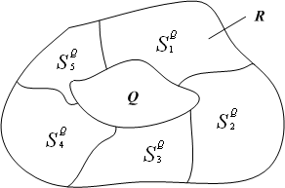
MSRM
Merging rule by Maximal similarity:
Merge R and Q if
Notes:
S表示Q的鄰近區域，假設現在要合併R&Q，若R所在的區域與Q的相關性最大才合併，不然就不合併。

Slide 12
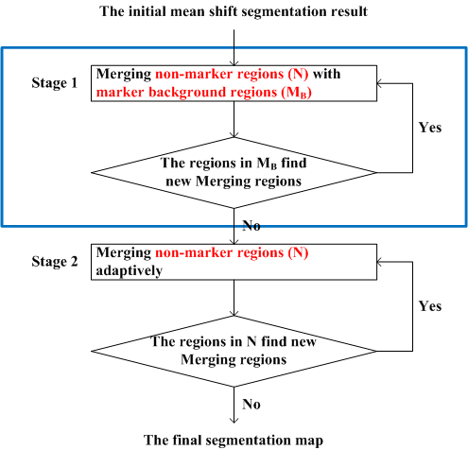
MSRM (Stage 1)

Slide 13
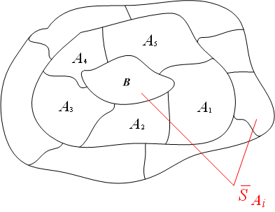
MSRM (Stage 1)
Merging non-marker regions (N) with marker background regions (M_{B}).
Step 1.1: For each region B ∈ M_{B}, form the set of its adjacent regions
Notes:
合併動作重複直到沒有新的合併動作才停。這邊使用的方法是去讓背景合併，意味合併完全部背景區域，也等於可抓出想要的object區域。

Slide 14
MSRM (Stage 1)
Step 1.2: For each A_{i} and A_{i} M_{B}, form its set of adjacent regions . There is
Step 1.3: Calculate If
, then
B = B ∪ A_{i}. Otherwise, B
and A_{i} will not merge.

Slide 15
MSRM (Stage 1)
Step 1.4: Update M_{B} and N accordingly.
Step 1.5: If the regions in M_{B} will not find new merging regions, the first stage ends. Otherwise, go back to Step 1.1.

Slide 16
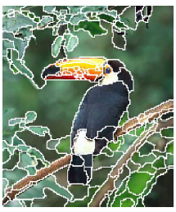
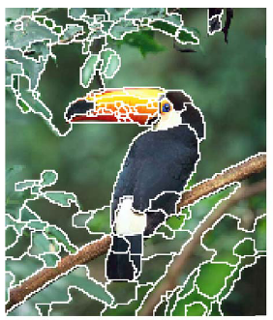
MSRM (Stage 1)
Left figure: Initial mean shift segmentation.
Right figure: The first stage (1st round).

Slide 17
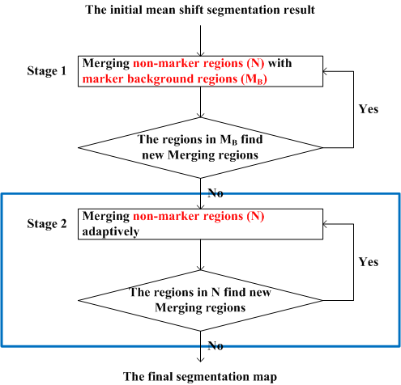
MSRM (Stage 2)

Slide 18
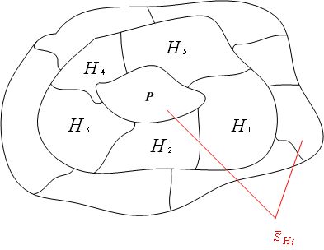
MSRM (Stage 2)
Merging non-marker regions (N) adaptively.
Step 2.1: For each region P ∈ N, form the set of its adjacent regions
Step 2.2: For each H_{i} that H_{i} M_{B}
and H_{i} M_{O}, form its set of
adjacent regions
. There is

Slide 19
MSRM (Stage 2)
Step 2.3: Calculate If
, then P = P ∪ H_{i}.
Otherwise, P and H_{i} will not merge.
Step 2.4: Update N.
Step 2.5: If the regions in N
will not find new merging
regions, the second stage
ends. Otherwise, go back to
Step 2.1.

Slide 20
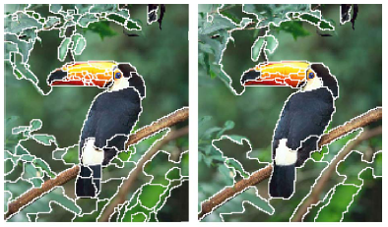
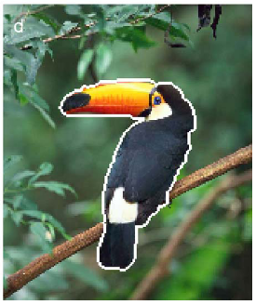
MSRM (Stage 2)
First figure: Initial mean shift segmentation.
Second figure: The first stage (1st round).
Third figure: The Second stage (1st round).
Last figure: The merging results.

Slide 21
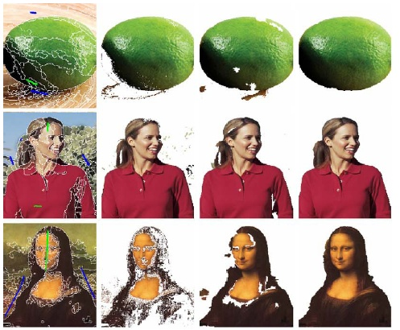
MSRM (Segmentation Results)
First column:
initial segmentation.
Second column:
segmentation
results by GC_{P}.
Third column:
segmentation
results by GC_{R}.
Last column:
segmentation
results by the
MSRM.

Slide 22
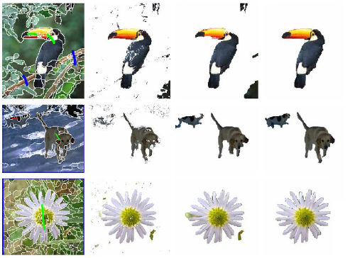
MSRM (Segmentation Results)

Slide 23
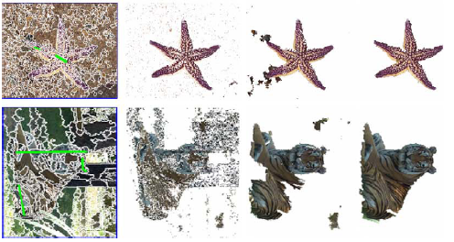
MSRM (Segmentation Results)

Slide 24
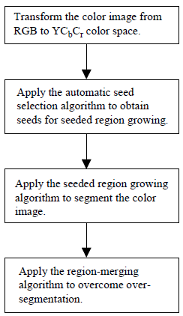
Color SRG algorithm [2]

Slide 25
Color SRG algorithm
Step 1: Transform the color image from RGB to YC_{b}C_{r} color space.
The RGB model is suitable for color display, but is not good for color analysis.
Notes:
不適合顏色分析原因是因為RGB各量之間有高相關性。而且在RGB空間的距離差距與然眼睛看到的差距不一樣。YCbCr可使強度&彩度的量可容易獨立控制。

Slide 26
Color SRG algorithm
Step 2: Apply the automatic seed selection algorithm to obtain seeds for seeded region growing.
For automatic seed selection, the following three criteria must be satisfied:
The seed pixel must have high similarity to its neighbors.
For an expected region, at least one seed must be generated in order to produce this region.
Seeds for different regions must be disconnected.

Slide 27
Color SRG algorithm
A pixel is classified as a seed pixel if it satisfies two conditions.
Condition 1: A seed pixel candidate must have the similarity higher than a threshold value.
Considering 3X3 neighborhood,
Where x can be Y, C_{b}, or C_{r}, and the mean value
Notes:
條件1是去看seed對他的鄰近區域相關性要夠高。

Slide 28
Color SRG algorithm
The total standard deviation:
Normalize the standard deviation to [0, 1]:
The similarity of a pixel to its neighbors:
Use Otsu’s method [5] to choose the threshold value automatically.

Slide 29
Color SRG algorithm
Condition 2: A seed pixel candidate must have the maximum relative Euclidean distance to its eight neighbors less than a threshold value (0.05).
The relative Euclidean distances of a pixel to its eight neighbors:
The maximum distance to its neighbors:
Notes:
條件2是用來確保seed不是兩區域的邊界。

Slide 30
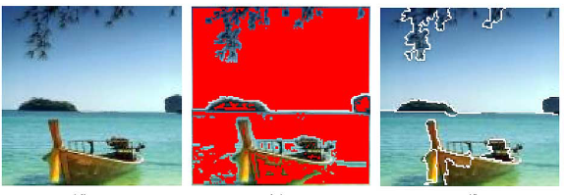
Color SRG algorithm
Notes:
條件二的Threshold設太低的話，被分到當seed的pixel數會變少，可能會是你想要的object沒被切出來。Threshold設太高的話，被分到當seed的pixel數會變多，而不同區域可能會被當成同一區域。這邊要注意，連在一起的seed被視為一個seed。

Slide 31
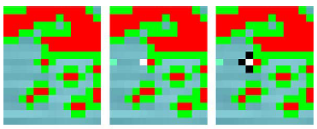
Color SRG algorithm
Step 3: Apply the seeded region growing algorithm to segment the color image.
Notes:
這篇PAPER做法是說會先把圖中綠色點記錄他與seed的距離從小排到大給Table，一次一個點掃，從距離最小那個店開始做，若那點的4-connect的label一樣就給他那個label，若不一樣就看那個label離他最近就分給他。之後一直更新Table&每區的mean值。

Slide 32
Color SRG algorithm
Step 4: Apply the region-merging algorithm to overcome over segmentation.
Criterion 1: If the mean color difference between two neighboring regions is less than a threshold value (0.1), we merge the two regions.
The color difference between two adjacent region R_{i} and R_{j} :
Notes:
先找出每一區和他的鄰近區域，去算出他們之間距離，找出最小距離，若小於所設的threshold就可以把那兩區域合併，並從新計算新區域的mean&距離，在繼續做下去，直到沒有新的區域在被合併。

Slide 33
Color SRG algorithm
Criterion 2: If the number of pixels in a region is smaller than a threshold (1/150 of the total number of pixels), the region is merged into its neighboring region with the smallest color difference.
Notes:
此過程結束當沒有區域大小小於所設的threshold。

Slide 34
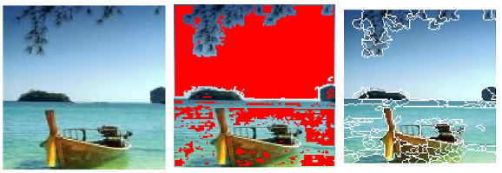
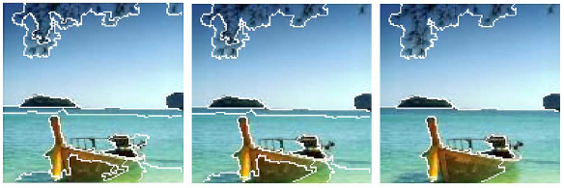
Color SRG algorithm (Segmentation Results)

Slide 35
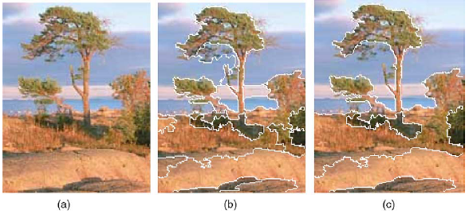
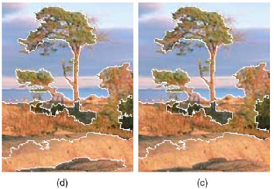
Color SRG algorithm (Segmentation Results)
Fig. (a): Original image.
Fig. (b): merging using 0.1 as the distance threshold value and 1/150 of the image size as the size threshold.
Fig. (c): further merging using the relative Euclidean distance threshold 0.2.
Fig. (d): further merging using threshold 0.15.
Fig. (e) : further merging using threshold 0.25.

Slide 36
Color SRG algorithm (Segmentation Results)
First column: initial segmentation.
Second column: segmentation results by color SRG.
Third column: segmentation
results by JSEG.
Notes:
JSEG狒狒鼻子分太多塊&背景也分太多塊。

Slide 37
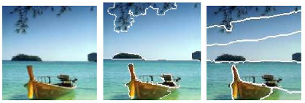
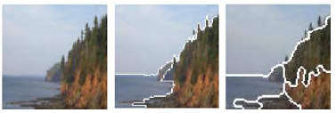
Color SRG algorithm (Segmentation Results)
Notes:
SRG可產生更精確的邊界。JSEG的class-map會使用顏色量化，使顏色資訊的detail會lost。

Slide 38
Color SRG algorithm (Segmentation Results)
First column: initial segmentation.
Second column: segmentation results by color SRG.
Third column: segmentation results by Ref. [6].
Notes:
若圖片有很多重複性高的texture(highly color textured)，可能會切失敗，因為平均值沒辦法代表某區域的性質。如圖樹跟花混在一起。

Slide 39
Conclusion
MSRM:
A novel region merging based interactive image segmentation method.
The scheme efficiently exploits the color similarity of the target object so that it is robust to the variations of input markers.
Color SRG algorithm:
By controlling the size of regions and the color difference of regions, the region-merging method can adjust dynamically according to different images to obtain satisfactory segmentation results.

Slide 40
Reference
[1] J. Ning, L. Zhang, D. Zhanga, C. Wu, “Interactive image segmentation by maximal similarity based region merging,” Pattern Recognition, vol. 43, Issue 2, pp. 445-456, Feb. 2010.
[2] F.Y. Shih, S. Cheng, “Automatic seeded region growing for color image segmentation,” Image and Vision Computing, vol. 23, issue 10, pp. 877-886, Sep. 2005.
[3] B. Sumengen, “Variational image segmentation and curve evolution on natural images, ” Ph.D. Thesis, University of California.
[4] X. Ren, J. Malik, “Learning a classification model for segmentation,” ICCV03, vol. 1, pp. 10–17, Nice, 2003.
[5] N. Otsu, “A threshold selection method from gray-level histogram”, IEEE Transactions on Systems, Man, and Cybernetics, vol. SMC-9, no. 1, pp. 62–66, Jan. 1979.
[6] J. Fan, D.K.Y. Yau, A.K. Elmagarmid, W.G. Aref, “Automatic image segmentation by integrating color-edge extraction and seeded region growing, ” IEEE Transactions on Image Processing, vol. 10, issue 10, pp. 1454–1466, Oct. 2001.

